Slide 1
Software Architectural Analysis to Overcome Internet Scale load

Slide 2
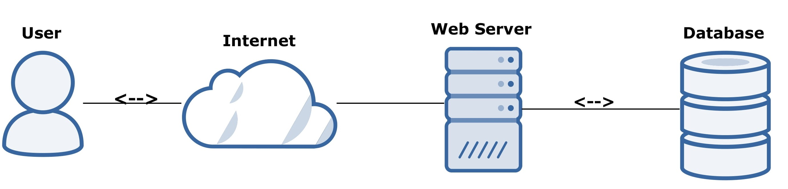
User Management Webservice
Application is running on single server and the client connect to the server directly without load balancing it look something like caption.
Disadvantages:
Server Failure: If the server goes down or something happens to the server the whole application will be interrupted and it will unavailable for the users for a certain period. It will create a bad experience for users which is unacceptable for service providers.
Server Overloaded: Server can handle a limitation of web requests if business grow and the number of requests increase the server will be overloaded.
To solve this issue we need to add additional servers and distribute the request evenly through all servers this can be handle by load balancer.

Slide 3
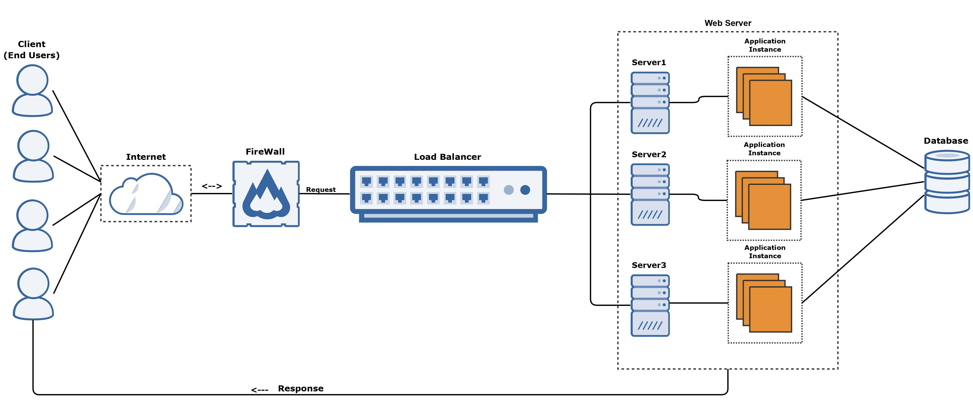
Multiple Server Architecture
To overcome overload issue added additional servers and configured application
If client send the request need to decide which server to be routed.
To solve the distribution issue added load balancer software's in front of server.

Slide 4
Load balancer
Load Balancing refers to efficiently distributing incoming network traffic across a group of backend servers also known as server farm or server pool.
A load balancer act as “traffic cop” sitting in front of servers and routing client request across all servers.
It ensures no one server is over worked which could degrade the performance.
Load balancing functions:
Distribute client request or network load efficiently across multiple servers.
Ensures high availability by reliability by sending request only to servers that are online
Provides flexibility to add or subtract servers as demand dictates.

Slide 5
Load balancing Algorithms
Round Robin: Request distributed across group servers sequentially.
Least Connections: A new request is sent to the server with the fewest current connections to clients
Least Time: Request sent to the server by a formula to combines the fastest response time and fewest connections.
Hash: Distributes the server based on key define such as the client IP address or the request URL.
Random with two choices: Pick two servers at random and sends the request to the one and then apply least connection algorithm.

Slide 6
Conclusion
If number of users increased need to add additional servers
To distribute request evenly need to place load balancer software in front of server
Load balancer will take care of distributing request by using algorithms
It will prevent the application from downtime hence this approach can help to overcome internet scale load.

Slide 7
Thank You

